Slide 1
Model Optimizer
Notes:
As we mentioned in the overview session, MO is not only doing the model conversion but also optimizes the model, then the question is, what kind of optimization does MO do to the model? And how much can you control it? To answer these questions, let’s take a closer look at MO.

Slide 2
Intel® Deep Learning Deployment Toolkit For Deep Learning Inference
Model Optimizer
A Python* based tool to import trained models and convert them to Intermediate Representation
Optimizes for performance or space with conservative topology transformations
Hardware-agnostic optimizations
Inference Engine
High-level, C/C++ and Python, inference runtime API
Interface is implemented as dynamically loaded plugins for each hardware type
Delivers advanced performance for each type without requiring users to implement and maintain multiple code pathways
Trained Models
Inference Engine
Common API
(C++ / Python)
Optimized Cross-platform Inference
CPU Plugin
Extendibility C++
Caffe*
GPU Plugin
Extendibility OpenCL™
TensorFlow*
Model Optimizer
Convert & Optimize
FPGA Plugin
MxNet*
IR
Myriad Plugin for Intel® NCS & NCS
Extendibility OpenCL™
IR
.data
Load, infer
ONNX*
Pytorch*, Caffe2* & more
HDDL Plugin for VAD*
IR = Intermediate Representation format
Kaldi*
GNA Plugin
GPU = Intel® CPU with integrated GPU/Intel® Processor Graphics, Intel® NCS = Intel® Neural Compute Stick (VPU)
*VAD = Intel® Vision Accelerator Design Products (HDDL-R)
OpenCL and the OpenCL logo are trademarks of Apple Inc. used by permission by Khronos
Notes:
MO is a Python-based console application; you will run it through a terminal with command-line parameters.
It loads a model into memory, reads all the layers and checks if each layer is supported or not. If yes, then builds the internal representation of the model, optimizes it, and finally produces the Intermediate Representation files. The .xml file is the topology, while a .bin file contains the weights and bias of a model;
if your model contains any unsupported layers, then the user will need to go through the custom layer process, which won’t be covered in this training.
The Intermediate Representation is the only format the Inference Engine accepts. Besides, users can also quantize the model into different data type, since some of the HW supports only one type of data precision, others might support more but work better with a certain data type, we will talk about quantization a few slides later.
There are two types of optimization, hardware related or not.
As we mentioned earlier, MO converts your model to the IR format, if there are layers in the model not supported by OpenVINO, MO will print out a message to let you know, then you will have to go through the Custom Layer process, which is an advanced topic we are not going to talk about in this training, but the best way to know whether your model can be converted or not is just run MO with it.
OK, now, let’s assume you have the model with all the layers supported, then MO also conducts topology level, hardware-agnostic optimization.
Then, when you call the IE APIs to load the converted model to the plugin of the hardware you selected to run the inference, the plugin is a DLL/shared library that contains complete implementation for inference on this particular device, each plugin has its internal optimization algorithms, and this is hardware related optimization, happens at runtime.

Slide 3
Model Optimizer: generic optimization
Model optimizer performs generic optimization
Node merging
Horizontal fusion
Batch normalization to scale shift
Fold scale shift with convolution
Drop unused layers (dropout)
The simplest way to convert a model is to run mo.py with a path to the input model file
By default, generic optimization will be automatically applied, unless manually set disable
Notes:
First, let’s see what kind of optimizations MO applies to your model, when the optimization happens, and what a user needs or can do to control the optimization.
Pre-trained models contain layers that are important for training, such as the “Dropout” layer. These layers are useless during inference and might increase the inference time. In many cases, these operations will be automatically removed.
Another example, if a group of operations can be represented as a single mathematical operation, the Model Optimizer recognizes such patterns and replaces this group of operation nodes with the only one operation. The result is an Intermediate Representation that has fewer operation nodes than the original model. This decreases the inference time.
By default, all these optimizations will automatically apply to your model, when you simply run the MO application by providing the model file name with the extension. And, if you don’t specify the name of the converted model and a directory to save the converted model, it will generate the IR files with the same name of your original model and place them in the same folder containing the original model.

Slide 4
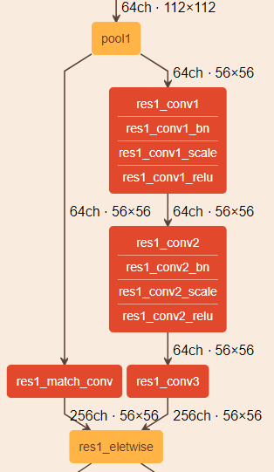
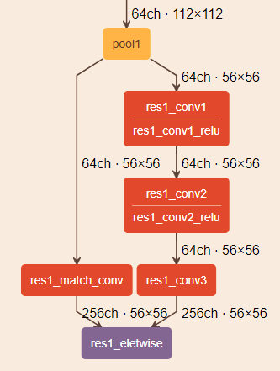
Model Optimization Techniques
Linear Operation Fusing: 3 stages
BatchNorm and ScaleShift decomposition: BN layers decomposes to Mul->Add->Mul->Add sequence; ScaleShift layers decomposes to Mul->Add sequence.
Linear operations merge: Merges sequences of Mul and Add operations to the single Mul->Add instance.
Linear operations fusion: Fuses Mul and Add operations to Convolution or FullybConnected layers.
Merged Caffe* Resnet269 block (from Netscope*)
Caffe* Resnet269 block (from Netscope)
Notes:
The most commonly applied optimization technique is Linear Operations Fusing.
Many convolution neural networks include “BatchNormalization” and “ScaleShift” layers that can be presented as a sequence of linear operations. These layers can be fused into previous Convolution or FullyConnected layers.
This Linear Operation Fusing technique contains three stages, first, “BatchNorm” and “ScaleShift” layers decomposition: where BN layers decompose to Mul->Add->Mul->Add sequence; ScaleShift layers decompose to Mul->Add sequence;
second, Linear operations merge: which merges the sequences of Mul and Add operations to the single Mul->Add instance;
third, Linear operations fusion: it fuses Mul and Add operations to Convolution or FullyConnected layers.
On the right hand, visualized Resnet269, we can see on the left, original model, Convolution layer was followed by the BatchNorm and ScaleShift layers, after MO, the BatchNorm, and ScaleShift layers were fused into Convolution layer.

Slide 5
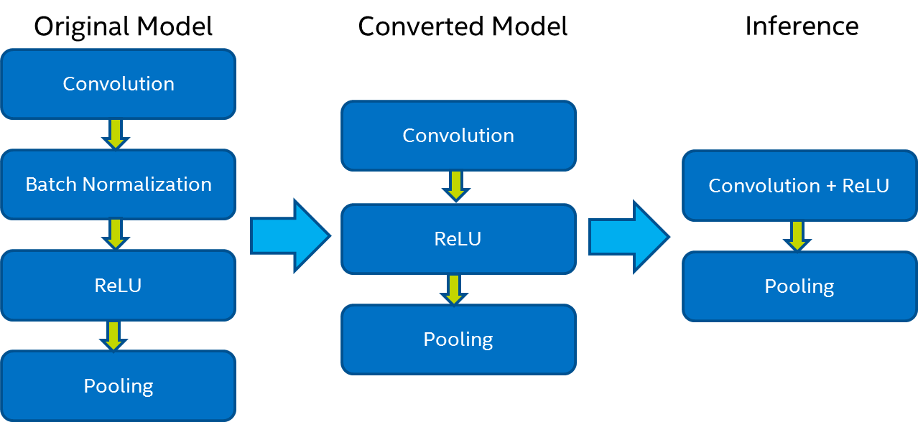
Model Optimizer: Linear Operation Fusing
Example
Remove Batch normalization stage.
Recalculate the weights to ‘include’ the operation.
Merge Convolution and ReLU into one optimized kernel.
Topology Optimization
HW agnostic
Runtime Optimization
HW related
Notes:
Here is a simpler look of Linear Operation Fusing, if we have an unconverted original model which contains four layers, Convolution, BatchNormalization, ReLU, and Pooling, and we are going to run the inference eventually on CPU.
After converting and optimizing with MO, the BN layer is fused into Convolution layer, we have one operation less than the original model.
Then, during inference, remember we mentioned plugins of IE have some internal optimization that happens at the runtime? This is it, during the inference Convolution layer can be merged with ReLU layer into one optimized kernel, then eventually, at the runtime, the optimized model has two layers less than the original model, which saves the computation cycles, and results in decreased inference time.

Slide 6
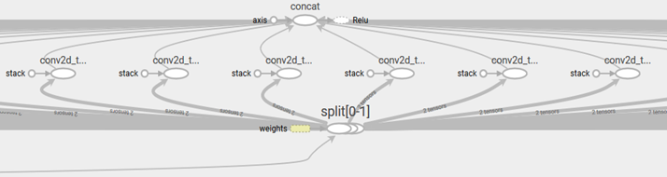
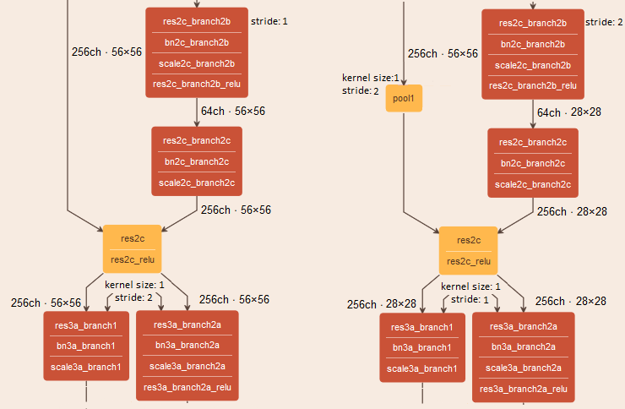
Model Optimizer: Framework or topology specific optimization
Grouped Convolutions Fusing
Grouped convolution fusing is a specific optimization that applies for TensorFlow* topologies. The main idea of this optimization is to combine convolutions results for the Split outputs and then recombine them using Concat operation in the same order as they were out from Split.
ResNet* optimization (stride optimization)
This optimization is to move the stride that is greater than 1 from Convolution layers with the kernel size = 1 to upper Convolution layers. In addition, the Model Optimizer adds a Pooling layer to align the input shape for a Eltwise layer, if it was changed during the optimization.
Split->Convolutions->Concat block from TensorBoard*
Notes:
In addition to the Linear Operation Fusing, there are other types of optimization techniques that are framework or topology specific. Here we see the Grouped convolution fusing is a specific optimization that applies for TensorFlow* topologies. The main idea of this optimization is to combine convolutions results for the Split outputs and then recombine them using “Concat” operation in the same order as they were outputted from “Split”.
Another one is ResNet optimization, this optimization is to move the stride that is greater than 1 from Convolution layers with the kernel size = 1 to upper Convolution layers. In addition, the Model Optimizer adds a Pooling layer to align the input shape for an Eltwise layer if it was changed during the optimization. All those optimizations can be disabled manually, you can refer to the MO documentation for details.

Slide 7

Model Optimizer: Quantization
--data_type {FP16,FP32,half,float}
Data type for all intermediate tensors and weights.
If original model is in FP32 and --data_type=FP16 is specified, all model weights and biases are quantized to FP16.
PLUGIN | FP32 | FP16 | Int8
CPU plugin | Supported and preferred | Supported | Supported
GPU plugin | Supported | Supported and preferred | Supported*
VPU plugins | Not supported | Supported | Not supported
GNA plugin | Supported | Supported | Not supported
FPGA plugin | Supported | Supported | Not supported
16 bits
16 bits
FP32
s
8 bit exp
23 bit mantissa
BF16
s
8 bit exp
7 bit mantissa
FP16
s
5 bit exp
10 bit mantissa
INT8
s
7 bit mantissa
Note:
1. To create INT8 models, you will need DL Workbench or Post Training Optimization Tool
2. FPGA also support FP11, convert happens on FPGA
Notes:
Next, let’s look at Quantization.
We know all the optimizations are HW agnostic, they apply to the model topology, while quantization is for the weights and bias, and guides choosing which HW you are going to run the inference.
On the chart at the right hand, we can see the which type of HW supports which data types. For CPU and GPU plugins, they support both FP32 and FP16, but it is preferred inferencing on CPU with FP32, while using FP16 on GPU. Also both CPU and GPU plugins support even lower precision INT8, but note here, INT8 cannot be quantized with MO, you will need to use Post Training Optimization Toolkit to do it, either in a command-line environment or through DL Workbench;
for VPU plugin, FP16 is the only supported data type, so if you decide to use the accelerator with Intel Movidius Myriad VPU, you will need to quantize your model to FP16 first;
for FPGA plugin, it supports more different data types, but anything other than FP32 or FP16, the quantization is happening on the FPGA, not through MO. To quantize a model using MO, simply add this –data_type parameter as shown at the bottom.
BF16 support: 3rd Gen Intel® Xeon® Scalable Processor with bfloat16

Slide 8

Post-Training Optimization Tool
Using the Python API, the Post-training Optimization Tool integrates with the Model Optimizer, DL Workbench and accuracy checker tools to streamline the development process
Enables a conversion technique of deep learning model that reduces model size into low precision data types, such as INT8, without re-training
Reduces model size while also improving latency, with little degradation in model accuracy and without model re-training.
Different optimization approaches are supported: quantization algorithms, sparsity, etc.
Performance Benchmarks 
https://docs.openvinotoolkit.org/latest/_docs_performance_int8_vs_fp32.html
Trained Model
Model trained using one of the supported framework
Dataset and Annotation
Accuracy and performance check
Statistics & JSON
Model Optimizer
Converts and optimizes trained model using a supported framework
IR
Post-training Optimization Tool
Conversion technique to quantize models to low precision for high performance
Accuracy Checker
Full-Precision IR
Environment (hardware) specifications
JSON
IR
Optimized IR
Inference Engine
Notes:
Add performance benchmark link https://docs.openvinotoolkit.org/latest/_docs_performance_int8_vs_fp32.html

Slide 9

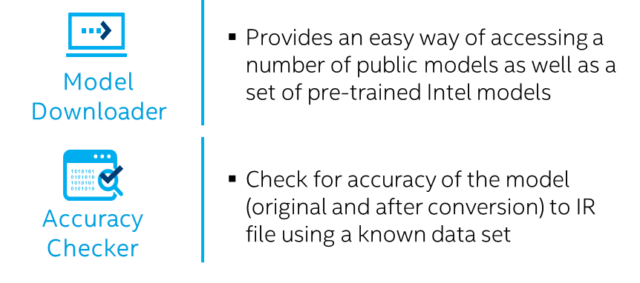
Speed up development with open source resources
Open source resources with pre-trained models, samples and demos
Computer Vision
Audio, Speech, Language
Other
Object detection
Object recognition
Reidentification
Volumetric segmentation
Semantic segmentation
Instance segmentation
3D reconstruction
Human pose estimation
Image processing
Action recognition
Image super resolution
Language processing
Speech to text
Text detection
Text recognition
Natural Language Processing
(Data Generation, Reinforcement Learning)
Compressed models
Image retrieval
And more..
Pre-trained models
https://github.com/opencv/open_model_zoo
Copyright © 2020, Intel Corporation. All rights reserved.
Notes:
Over, 50 models & samples are included in the package. there is a model downloader that will also download public models.
Having a pre-trained model is the pre-requisite of using the OpenVINO toolkit.
Open Model Zoo provides both Intel and public pre-trained models for developers to download and use for free, the difference is Intel pre-trained models have already been converted to the IR format, while the public models still need to be converted with MO. You can use these models directly as part of your solution or try ideas before you have a fully well-trained model. The pre-trained models fall into several different use cases. Here’s the link to the GitHub repository.

